Slide 1
Digital Logic & Boolean Algebra Interesting bit flipping video youtube.com/watch?v=AaZ_RSt0KP8 Summary • NOT, AND, OR, XOR Boolean operations and logic gates • Basic Logic Circuits and Truth Tables • Bit Masking Operations

Slide 2
Digital Logic & Boolean Algebra
Binary can be considered as truth values:
0 = False, 1 = True
Boolean Algebra: the laws of algebra for truth values
consists of operations on truth values, the result of which is another truth value
fundamental for the design of logic circuits and for tests in computer programming
CPU hardware consists of circuits built from logic gates – logic gates perform Boolean Algebra
George Boole(/buːl/; 2 November 1815–8 December 1864) was a largely self-taught English mathematician, philosopher and logician, most of whose short career was spent as the first professor of mathematics at Queen's College, Cork in Ireland. He worked in the fields of differential equations and algebraic logic and is best known as the author of The Laws of Thought(1854) which contains Boolean algebra. -from Wikipedia

Slide 3
Gates and Transistors
Logic gates are made up of transistors
Remember that a transistor is just a switch that can be open or closed.
https://www.electronics-tutorials.ws/transistor/tran_4.html
If open, no current flows (“0”)
If closed, current flows (“1”)
Two basic types
Current used to turn the switch on (off be default) NPN transistor
Current used to turn the switch off (on by default) PNP transistor

Slide 4
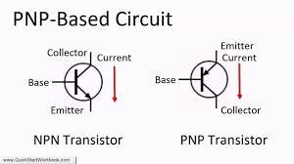
Gates and Transistors cont’d

Slide 5
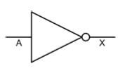
Boolean Algebra
Boolean Operator: NOT
NOT returns the opposite value
i.e., True becomes False, False becomes True
NOT(written as /A or -A or sometimes !A or A or ~A
A | /A
1 | 0
0 | 1

Slide 6
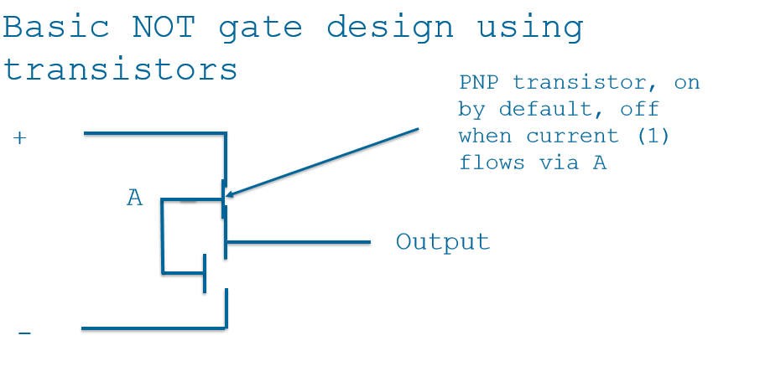

Slide 7

AND Gate
AND is true when both inputs are true
written as x.y or sometimes x ∧ y or as xy
A | B | X =A.B
0 | 0 | 0
0 | 1 | 0
1 | 0 | 0
1 | 1 | 1

Slide 8
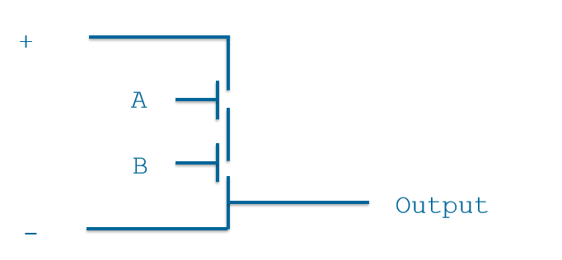
Basic AND Gate Design Using Transistors

Slide 9
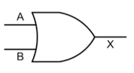
OR Gate
OR is true when any input is true – written (confusingly!) as x+y or sometimes x∨y – Sometimes referred to as inclusive or
A | B | X =A+B
0 | 0 | 0
0 | 1 | 1
1 | 0 | 1
1 | 1 | 1

Slide 10
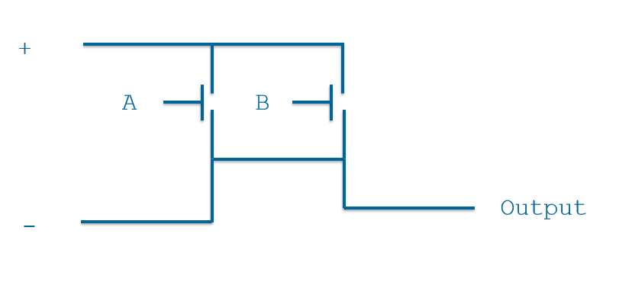
Basic OR Gate Design Using Transistors

Slide 11

XOR Gate
XOR (exclusive OR) is similar to OR, except it is true when only one, and exclusively one, input is true – written as
X = A ⊕ B.
A | B | X = A ⊕ B
0 | 0 | 0
0 | 1 | 1
1 | 0 | 1
1 | 1 | 0

Slide 12
Logic Gates
Computer hardware is made from logic gates
Basic logic gates: AND, OR, NOT
Derived negated gates: NAND, NOR, XOR, XNOR
Any logic circuits can be build from combinations of just AND, OR, NOT – alternatively, use just NAND, NOR

Slide 13
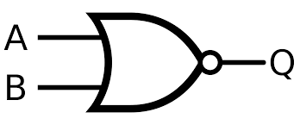
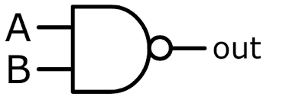
Logic Gates
NOR gate
Q=/(A+B)
NAND gate
out= /(A.B)

Slide 14
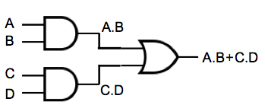
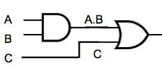
Logic Circuits
A.B+C (usual order of precedence)
A.B+C.D

Slide 15
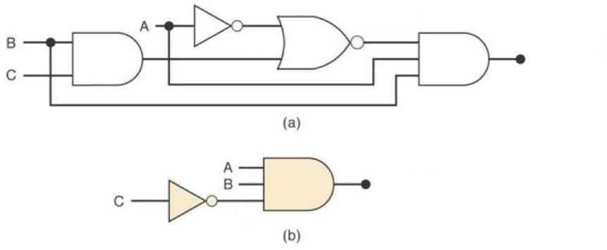
Creating a Truth Table

Slide 16
Creating the Truth Table
A | B | C | B.C | /A | /A+B.C | /(/A+B.C) | A.B | /(/A+.B.C).A.B | /C | A.B./C
0 | 0 | 0 | 0 | 1 | 1 | 0 | 0 | 0 | 1 | 0
0 | 0 | 1 | 0 | 1 | 1 | 0 | 0 | 0 | 0 | 0
0 | 1 | 0 | 0 | 1 | 1 | 0 | 0 | 0 | 1 | 0
0 | 1 | 1 | 1 | 1 | 1 | 0 | 0 | 0 | 0 | 0
1 | 0 | 0 | 0 | 0 | 0 | 1 | 0 | 0 | 1 | 0
1 | 0 | 1 | 0 | 0 | 0 | 1 | 0 | 0 | 0 | 0
1 | 1 | 0 | 0 | 0 | 0 | 1 | 1 | 1 | 1 | 1
1 | 1 | 1 | 1 | 0 | 1 | 0 | 0 | 0 | 0 | 0
The 2 circuits are logically equivalent because the final columns are identical.

Slide 17
Simplifying a Circuit using the Boolean Algebra Rules, (Laws)

Slide 18
Boolean Algebra Rules, (Laws) https://www.electronics-tutorials.ws/boolean/bool_6.html
Boolean Algebra Rules
Commutative Laws | A+B =B+A and A.B=B.A
Associative Laws | A+(B+C)= A+B+C=(A+B)+C A.(B.C) = (A.B).C
Distributive Laws | A.(B+C) =A.B+A.C A+B.C = (A+B).(A+C)
De Morgan’s Laws | /(A+B) =/A./B and /(A.B) =/A+/B
Idempotent Laws | A+A=A and A.A=A
Absorption Laws | A+A.B= A and A.(A+B)= A
Involation Law –Double Negation | //A = A
Identity Laws | A+0 = A and A.1 =A
Annulment Laws | A+1 = 1 and A.0 = 0
Complementary Laws | A+/A = 1 and A./A= 0
Special Identity Law | A.B + /A.B = B

Slide 19
Simplifying a Circuit using the Boolean Algebra Rules, (Laws)
/(/A + (B.C)) . A.B (Output of circuit a)
De Morgan's Law: //A ./(B.C). A.B
The //A= A Law : => A ./(B.C). A.B
The Commutative Law, X.Y=Y.X => A .A. /(B.C). B
The Idempotent Law , A.A = A : = >A. /(B.C). B
The Commutative Law X.Y=Y.X=>A.B./(B.C)
De Morgan’s Law => A.B.(/B+/C)
The Distributive Law =>A.B.(/B+/C) = A.B./B + A.B./C
The Complement Law, B./B =0 and Annulment Law D.0=0 and Identity Law D+0=D: => A.B./C
This is circuit b) !
Therefore, the 2 circuits are logically equivalent.

Slide 20
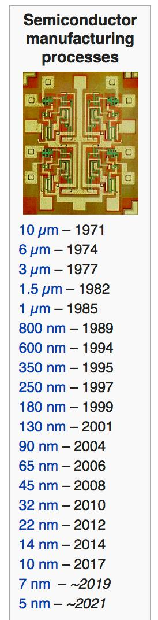
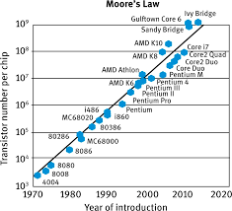
Moore’s Law
In 1965, Gordon Moore, founder of Fairchild, and then Intel predicted that the number of transistors per unit or area would double every two years.

Slide 21
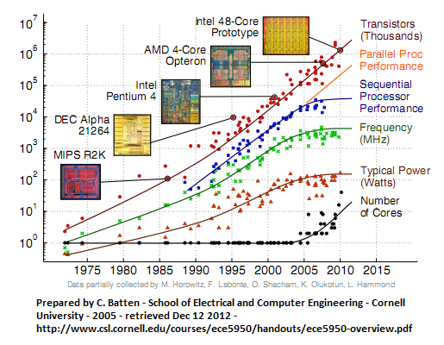
The Evolution of CPU’s

Slide 22

More Minaturisation changes during last decade…
… and Price

Slide 23
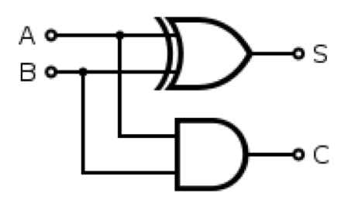
Logic Circuits-Half Adder
Say we wanted to construct an adder, which adds two bits together and outputs the sum (as a single bit) and a carry bit – called a half adder
– truth table:
Sum is A ⊕ B.
Carry is A.B
A | B | Sum | Carry
0 | 0 | 0 | 0
0 | 1 | 1 | 0
1 | 0 | 1 | 0
1 | 1 | 0 | 1

Slide 24
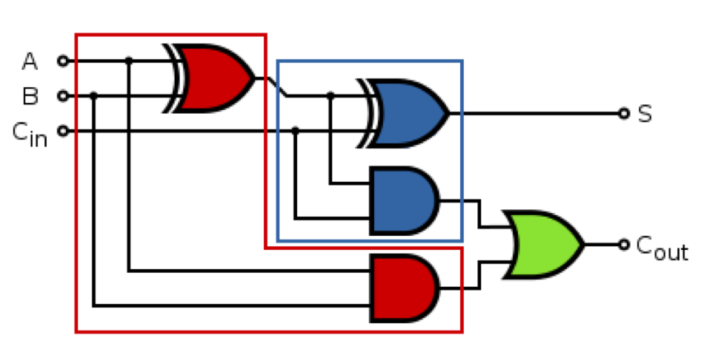
Logic circuits – Full Adder
We could combine two half adders to make a full adder (which accepts 3 inputs: A, B and a carry-in)
Full adders can be cascaded together to make a parallel adder that can add multi-bit binary numbers

Slide 25
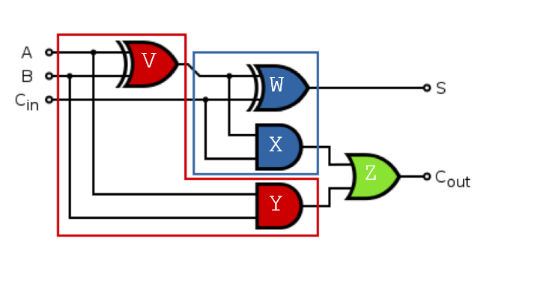
Logic circuits – Full Adder
We can build a truth table to examine the behaviour of the full-adder

Slide 26
Logic circuits –Truth Table for the Full Adder
A | B | C (c_{in} ) | V=A XOR B | W=Sum =V XOR C | X=V AND C | Y=A AND B | Z=Cout=X OR Y
0 | 0 | 0 | 0 | 0 | 0 | 0 | 0
0 | 0 | 1 | 0 | 1 | 0 | 0 | 0
0 | 1 | 0 | 1 | 1 | 0 | 0 | 0
0 | 1 | 1 | 1` | 0 | 1 | 0 | 1
1 | 0 | 0 | 1 | 1 | 0 | 0 | 0
1 | 0 | 1 | 1 | 0 | 1 | 0 | 1
1 | 1 | 0 | 0 | 0 | 0 | 1 | 1
1 | 1 | 1 | 0 | 1 | 0 | 1 | 1

Slide 27
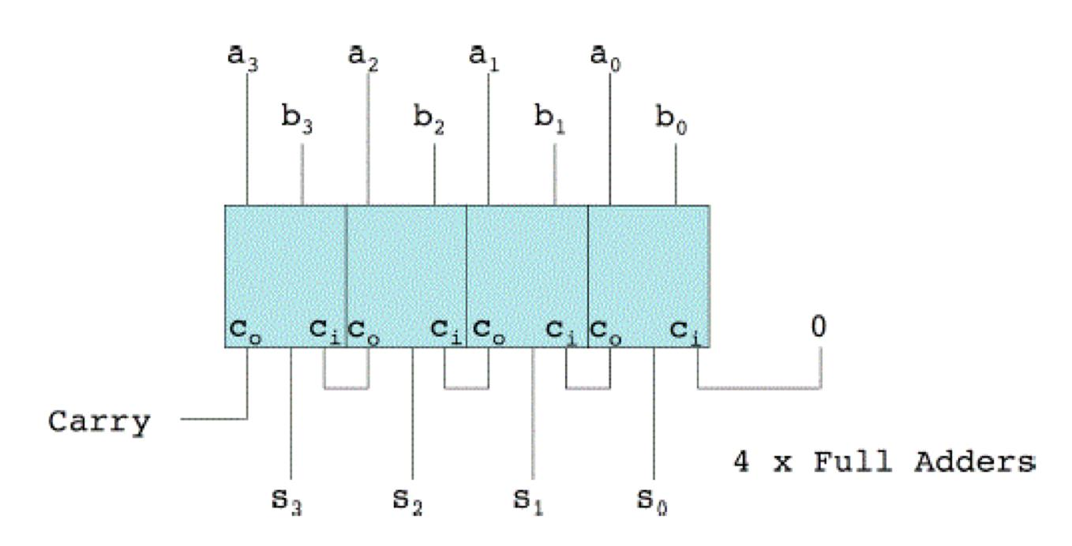
Logic Circuits –Parallel Adder
Parallel adder example
4 cascaded full-adders to add two 4-bit binary numbers
the carry-out of each full-adder feeds into carry-in of the next full-adder
the first carry-in is set to 0

Slide 28
Bit Masking
Bit masks uses Boolean operations to access individual bits from binary data
Used in ‘low level’ programming
device drivers and other hardware configuration/communication
data packet encoding/decoding
low level graphics
Switching LEDs on and off (Arduino)

Slide 29
Bit Masking- Resetting a Particular Bit
To reset (i.e. make 0) a bit in a byte, A, AND it with a mask of all 1’s except the bit to reset e.g. reset the LSB (bit 0) of any byte A:
A = XXXX XXXX₂, where X is 0 or 1
A AND M= XXXX XXXX₂ AND 1111 1110₂= XXXX XXX0₂
–
Bit No | 7 | 6 | 5 | 4 | 3 | 2 | 1 | 0
A | X | X | X | X | X | X | X | X
BITWISE AND | & | & | & | & | & | & | & | &
Mask =M | 1 | 1 | 1 | 1 | 1 | 1 | 1 | 0
A AND M | X | X | X | X | X | X | X | 0

Slide 30
Bit Masking- e.g. Resetting a Particular Bit, bit 0
Example byte: 1000 1101₂ = 8D₁₆
In Java:
short data = 0x8D;
short bitmask = 0xFE;
short result = (short) (data & bitmask); System.out.println(String.format("%x",result));
Bit No | 7 | 6 | 5 | 4 | 3 | 2 | 1 | 0
E(EXAMPLE) | 1 | 0 | 0 | 0 | 1 | 1 | 0 | 1
BITWISE AND | & | & | & | & | & | & | & | &
Mask =M | 1 | 1 | 1 | 1 | 1 | 1 | 1 | 0
E AND M | 1 | 0 | 0 | 0 | 1 | 1 | 1 | 0

Slide 31
Bit Masking- Setting a Particular Bit
To set (i.e. make 1) a bit in a byte, OR it with a mask of all 0’s except the bit to set e.g. set bit 4 :
A = XXXX XXXX₂, where X is 0 or 1
A OR M= XXXX XXXX₂ OR 0001 0000₂= XXX1 XXXX₂
Bit No | 7 | 6 | 5 | 4 | 3 | 2 | 1 | 0
A | X | X | X | X | X | X | X | X
BITWISE OR | | | | | | | | | | | | | | | |
Mask =M | 0 | 0 | 0 | 1 | 0 | 0 | 0 | 0
A OR M | X | X | X | 1 | X | X | X | X

Slide 32
Bit Masking- e.g. Setting a Particular Bit, bit 4
Example byte: 1000 1101₂ = 8D₁₆
In Java:
short data = 0x8D;
short bitmask = 0x10;
short result = (short) (data | bitmask); System.out.println(String.format("%x",result));
Bit No | 7 | 6 | 5 | 4 | 3 | 2 | 1 | 0
E(EXAMPLE) | 1 | 0 | 0 | 0 | 1 | 1 | 0 | 1
BITWISE OR | | | | | | | | | | | | | | | |
Mask =M | 0 | 0 | 0 | 1 | 0 | 0 | 0 | 0
E OR M | 1 | 0 | 0 | 1 | 1 | 1 | 0 | 1

Slide 33
Bit Masking- “Flipping”/Toggling a bit
To flip a bit in a byte (0->1, 1->0), XOR it with a mask of all 0’s except the bits to flip e.g., flip the bits 2 and 3 of A, any byte.
A = XXXX XXXX₂, where X is 0 or 1
A XOR M= XXXX XXXX₂ OR 0000 1100₂= XXXX /X/XXX₂
–
Bit No | 7 | 6 | 5 | 4 | 3 | 2 | 1 | 0
A | X | X | X | X | X | X | X | X
BITWISE XOR | ^ | ^ | ^ | ^ | ^ | ^ | ^ | ^
Mask =M | 0 | 0 | 0 | 0 | 1 | 1 | 0 | 0
A XOR M | X | X | X | X | /X | /X | X | X

Slide 34
Bit Masking- e.g. Flipping Particular Bits, bits 2 and 3
Example byte: 1000 0101₂ = 85₁₆
In Java:
short data = 0x85;
short bitmask = 0x0C;
short result = (short) (data | bitmask); System.out.println(String.format("%x",result));
Bit No | 7 | 6 | 5 | 4 | 3 | 2 | 1 | 0
E(EXAMPLE) | 1 | 0 | 0 | 0 | 0 | 1 | 0 | 1
BITWISE XOR | ^ | ^ | ^ | ^ | ^ | ^ | ^ | ^
Mask =M | 0 | 0 | 0 | 0 | 1 | 1 | 0 | 0
E XOR M | 1 | 0 | 0 | 0 | 1 | 0 | 0 | 1

